Slide 1
HSEEP
How Simple Exercises Explode Perpetually???
Karla Black,
Kent County Health Department

Slide 2
What is HSEEP?
“A consistent approach to capabilities-based exercise program management that uses a common methodology to measure progress toward building, sustaining, and delivering core capabilities.”

Slide 3
HSEEP Guidance
HSEEP Fundamentals
Program Management
Design and Development
Conduct
Evaluation
Improvement Planning
http://www.fema.gov/media-library-data/20130726-1914-25045-8890/hseep_apr13_.pdf

Slide 4
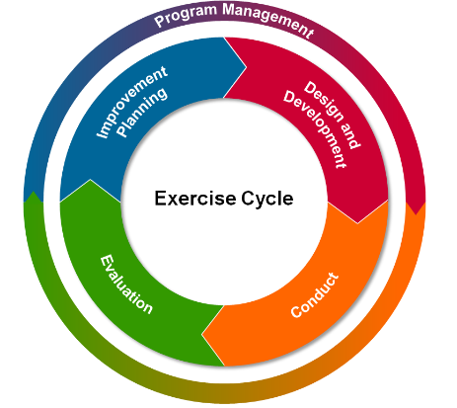
The Exercise Cycle

Slide 5
Where priorities come from
National threats and hazards
Jurisdictional threats and hazards
Hazard vulnerability analysis
Threats and Hazards
Areas for Improvement/
Capabilities
Real-world incident corrective actions
Exercise corrective actions
Identified and/or perceived areas for improvement
External Sources Requirements
Industry reports
State or national preparedness reports
Homeland security strategies
Accreditation standards and/or requirements
Grants or funding-specific requirements
Occupational Safety and Health Administration regulations
Accreditation Standards/Regulations

Slide 6
Training and Exercise Planning Workshop (TEPW)
Translate priorities into specific objectives and exercises
Track IP actions against current capabilities, training, and exercises
Coordinate exercise activities
Identify and coordinate possible funding sources
MCM ORR – Capability 3, Function 5 b & c

Slide 7
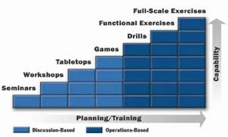
Types of Exercises

Slide 8
HSEEP is guidance, not law!
At least according to FEMA
Not all exercises require the same amount of work/planning.
Planning meetings
Documentation
Capabilities differ across disciplines
After Action Reports/Improvement Plans
Make it fit for you!

Slide 9
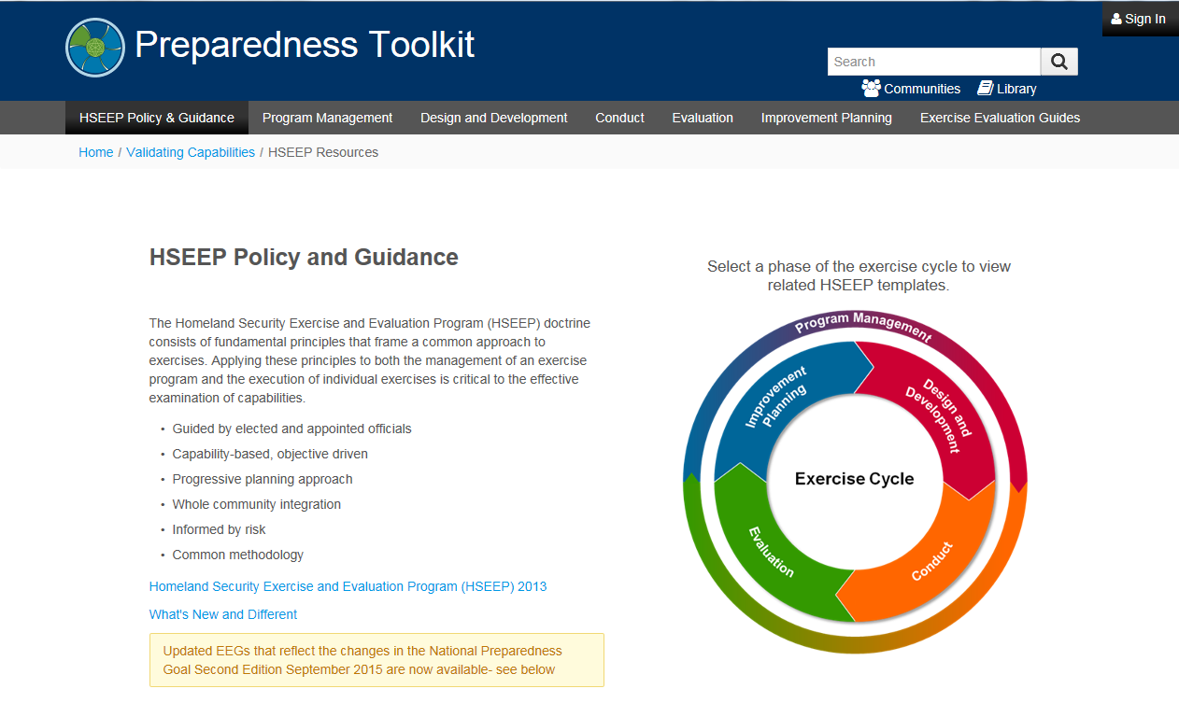
Preparedness Toolkit
https://preptoolkit.fema.gov/web/hseep-resources

Slide 10
Courses that are available
FEMA Independent Study Courses (Online)
IS-120.a – An Introduction to Exercises
IS-130 – Exercise Evaluation and Improvement Planning
FEMA L146 – HSEEP
Online delivery or in person
FEMA’s Master Exercise Practitioner Program
3 courses over 3 weeks at the Emergency Management Institute (EMI)
Application period starts May 1
MCM ORR
Capability 3, Function 5, Planning b: Advanced

Slide 11
AAR
The After Agony Report
Larry Zimmerman,
MDHHS

Slide 12
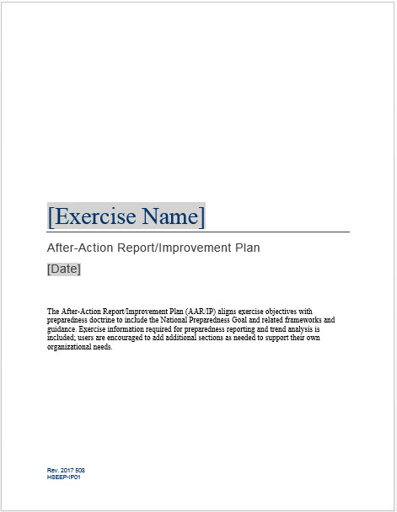
After Action Report (AAR)
Demystifying the AAR

Slide 13
Why AAR? A few reasons:
To prove to the DEPR/CDC completion of training and exercise deliverables/requirements
To verify strengths or identify weaknesses in plans, training and equipment
To build a roadmap to correct identified gaps
Funding opportunities/Leadership buy-in

Slide 14
Why AAR? A few more reasons:
To learn from and share our experiences?
To document new ideas and unique processes?
To build community relationships?
Score ultimate level on the ORR

Slide 15
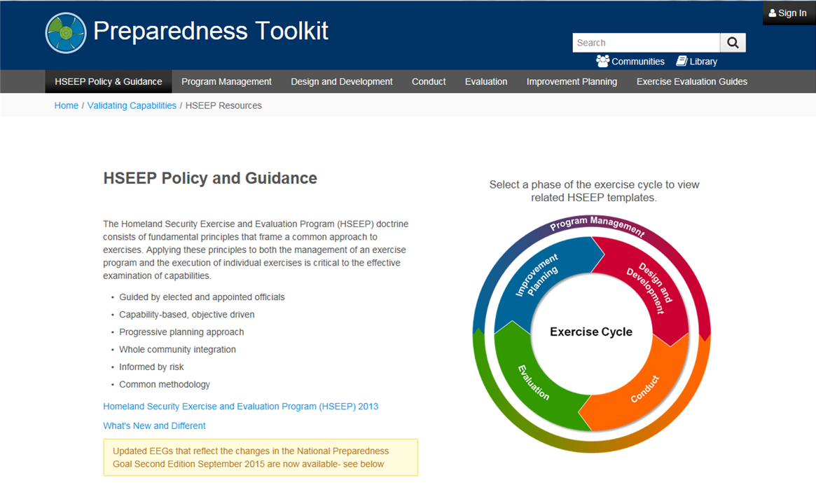
The HSEEP AAR Template
Download from the Preparedness Toolkit
https://preptoolkit.fema.gov/web/hseep-resources

Slide 16
Basic sections of the HSEEP AAR
Cover Page
Exercise Overview
Analysis of Capabilities
Improvement Plan

Slide 17
Cover Page

Slide 18
Exercise Overview
Exercise Name | [Insert the formal name of exercise, which should match the name in the document header]
Exercise Dates | [Indicate the start and end dates of the exercise]
Scope | This exercise is a [exercise type], planned for [exercise duration] at [exercise location]. Exercise play is limited to [exercise parameters].
Mission Area(s) | [Prevention, Protection, Mitigation, Response, and/or Recovery]
Capabilities | [List the core capabilities being exercised]
Objectives | [List exercise objectives]
Threat or Hazard | [List the threat or hazard (e.g. natural/hurricane, technological/radiological release)]
Scenario | [Insert a brief overview of the exercise scenario, including scenario impacts (2-3 sentences)]
Sponsor | [Insert the name of the sponsor organization, as well as any grant programs being utilized, if applicable]
Participating Organizations | [Insert a brief summary of the total number of participants and participation level (i.e., Federal, State, local, Tribal, non-governmental organizations (NGOs), and/or international agencies). Consider including the full list of participating agencies in Appendix B. Delete Appendix B if not required.]
Point of Contact | [Insert the name, title, agency, address, phone number, and email address of the primary exercise POC (e.g., exercise director or exercise sponsor)]

Slide 19
Analysis of Capabilities
Aligning exercise objectives and core capabilities provides a
consistent taxonomy for evaluation that transcends individual
exercises to support preparedness reporting and trend analysis.
Table 1 includes the exercise objectives, aligned core capabilities,
and performance ratings for each core capability as observed
during the exercise and determined by the evaluation team.
Objective | Core Capability | Performed without Challenges (P) | Performed with Some Challenges (S) | Performed with Major Challenges (M) | Unable to be Performed (U)
[Objective 1] | [Core capability]
[Objective 2] | [Core capability]
[Objective 3] | [Core capability]
[Objective 4] | [Core capability]

Slide 20
Analysis of Capabilities

Slide 21
Custom AAR writing
Linking Capabilities, Objectives, and Functions
Referencing plans/processes
Capability 1: Community Preparedness
Function | ID | Operational Implementation Element | Exercise Objectives/Activities
Function 2: Build community partnerships to support health preparedness | 1 | The jurisdiction can provide evidence of how the roles and responsibilities of how private sector, local, state, and regional partners have been used. | VBCDHD will designate roles and responsibilities to volunteers within Jurisdiction based on exercise scenario.
Analysis: VBCDHD successfully identified roles needed to respond the scenario. Specific qualifications for individuals were identified based on how volunteers resisted themselves within MI Volunteer Registry. By registering as a volunteer within MI Volunteer Registry, members of the private sector, local, state, and regional partners are agreeing to accept roles and responsibilities during a public health emergency based on their availability. During the exercise VBCDHD tested the functionality of establishing a mission, and creating deployment/assignments lists based on roles and responsibilities of the scenario. The creation of missions, deployment groups and assignments lists were completed to the best of the ability of the registered volunteers. Improvement Plan: NA
Capability Analysis:

Slide 22
Improvement Plan
Core Capability | Issue/Area for Improvement | Corrective Action | Capability Element | Primary Responsible Organization | Organization POC | Start Date | Completion Date
Capability 1: [Capability Name] | 1. [Area for Improvement] | [Corrective Action 1]
Capability 1: [Capability Name] | 1. [Area for Improvement] | [Corrective Action 2]
Capability 1: [Capability Name] | 2. [Area for Improvement] | [Corrective Action 1]
Capability 1: [Capability Name] | 2. [Area for Improvement] | [Corrective Action 2]
Capability 2: [Capability Name] | 1. [Area for Improvement] | [Corrective Action 1]
Capability 2: [Capability Name] | 1. [Area for Improvement] | [Corrective Action 2]
Capability 2: [Capability Name] | 2. [Area for Improvement] | [Corrective Action 1]
Capability 2: [Capability Name] | 2. [Area for Improvement] | [Corrective Action 2]

Slide 23
Tips for AAR writing
AAR writing starts at the beginning of the exercise design process
Measurable Objectives
Strong Evaluations
Collaboration and Teamwork

Slide 24
Why AAR?
To continually measure and increase our ability to protect the public:

Slide 25
Open Discussion

