Slide 1
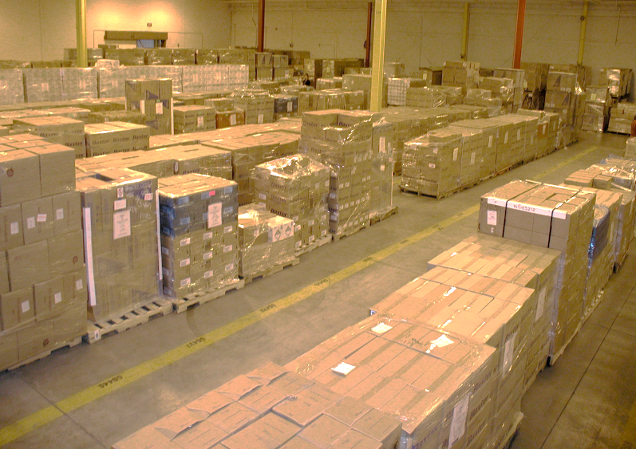
Healthcare Public Health (HPH) Sector Integrated Risk Assessment Toolkit
Local Public Health Implementation
Project Technical Assistance
January 2019

Slide 2
Objectives
To familiarize local health department emergency preparedness coordinators with toolkit content, functionality and user interface
To capture feedback and comments to submit to the US Department of Health and Human Services for future modifications to the toolkit
To assess threats, vulnerability and consequences for each public health facility within a planning jurisdiction

Slide 3
Capability 1: Community Preparedness
Function 1: Determine risks to the health of the jurisdiction
Identification of potential hazards, vulnerabilities, and risks related to population characteristics
Defined valuation of risk, including formula
Relation between risks to human impact and interruption of public health services
Probability of risks and hazards to a defined jurisdiction
Size and characteristics of the jurisdiction’s population

Slide 4
Overview
The HPH Sector Integrated Risk Toolkit is an all-hazards risk assessment methodology for facilities and organizations in the healthcare and public health sector. This methodology measures risk as the product of the following three factors as they relate to public health infrastructure:
Likelihood of a hazard occurring
Vulnerability to disruption from the hazard
Level of impact the hazard will cause if it occurs
The HPH Sector Integrated Risk Toolkit does not provide for the accurate measure for the following:
Overall risk and vulnerability for an entire planning jurisdiction
Social characteristics of a planning jurisdiction

Slide 5
Overview
Determination of risk is measured as the product of three factors: 1) the likelihood of a threat or hazard occurring (Threat), the vulnerability of an operation to disruption from a threat or hazard (Vulnerability), and the level of impact the threat or hazard will cause should it occur (Consequence)
The tool is broken into three separate modules:
Threat/Hazard Assessment Module (THAM)
Rapid Infrastructure Survey Tool Vulnerability Module (RIST-V)
Rapid Infrastructure Survey Tool Consequence and Criticality Module (RIST-C)
All modules are accessed through a dashboard, which calculates risk for each facility using the following formula:
Risk = T x V x C

Slide 6
Getting Started
Go To: https://www.phe.gov/Preparedness/planning/RISC/Pages/default.aspx
Download and Extract (unzip) the compressed files
For the toolkit to function properly, do not change the names of the files or folders within the HPH RISC folder or move them once installed
Make sure that all of the modules are in the same folder (HPH_RISC_Dasboard, HPH_RISC_THAM, HPH_RISC_RISTV, and HPH_RISC_RISTC)
Open HPH_RISC, select HPH_RISC_Dashboard
Resources:
Frequently Asked Questions
Toolkit Reference Guide
Threat/Hazard Assessment Module Narrative

Slide 7
DASHBOARD
Allows for clear navigation between THAM, RIST-V, and RIST-C modules, as well as cumulative summary of data entered
Open HPH_RISC_Dashboard
Select “START”
Enter Facility Name
Select “Start THAM”

Slide 8
Threat/Hazard Assessment Module
Data-driven module/tool to identify most relevant threats and hazards facing a facility using geographic location and internet-based data on hazard occurrences to estimate likelihood
Local health departments should use this module to identify both internal and external threats/hazards to their public health facility
External threats that are not relevant to the jurisdiction (tsunami or volcano) may be skipped
34 distinct external hazards (HAZMAT spills, inclement weather, tsunami)
33 local/internal hazards (HVAC failure, theft, etc.)

Slide 9
Threat/Hazard Assessment Module
Series of questions used to generate a Threat/Hazard Rating that describes relative likelihood of occurrence.
Facility Characterization
Basic information regarding the location/function of facility
Individual Hazards
Allows access of 34 internet-based sources for data needed to calculate threat/hazard for specific area
Local Hazards
33 local, facility-level hazards for which no national or sector level data is available
Considerations for working with local data sources (internal and external) for collection

Slide 10
Threat/Hazard Assessment Module
Open HPH_RISC_Dashboard
Select “START”
Enter Facility Name
Select “Start THAM”
Follow instructions to answer Facility Characterization questions
Follow instructions to enter individual hazard data from internet-based data sources
Select the frequency of occurrence for internal facility-level hazards
Select “View Results”
Select “Finish THAM” to import scores into dashboard and close the THAM worksheet

Slide 11
RIST - Vulnerability Module
Survey-style questionnaire used to measure facility vulnerability to disruption from threats/hazards. Vulnerability scores are calculated illustrate the number of protective measures and procedures in place as determined by responses
Resilience Management
Business Continuity; Emergency Preparedness; Information Sharing; Climate Change
Physical Security
Physical Security Organization, Policies, Plans; Personnel Surety; Security Force; Physical Access
Critical Dependencies
Information Technology; Electricity; Water; Transportation; Communications; Communications
Cybersecurity
Identification; Protection

Slide 12
RIST - Vulnerability Module
Survey-style questionnaire used to measure facility vulnerability to disruption from threats/hazards. Vulnerability scores are calculated illustrate the number of protective measures and procedures in place as determined by responses
Resilience Management
Business Continuity; Emergency Preparedness; Information Sharing; Climate Change
Physical Security
Physical Security Organization, Policies, Plans; Personnel Surety; Security Force; Physical Access
Critical Dependencies
Information Technology; Electricity; Water; Transportation; Communications; Communications
Cybersecurity
Identification; Protection

Slide 13
RIST - Vulnerability Module
Return to Dashboard and select “Start RIST-V”
In RIST-V, select “Start RIST-V” to begin
Answer Facility/Asset survey questions
Answer Resilience questions
Answer Physical Security questions
Answer Critical Dependencies questions
Answer Cybersecurity questions
On results page, click “Finish RIST-V” button

Slide 14
RIST – Criticality Module
Contains questions to derive measurement of criticality through generation of a Criticality Rating that can be used as a measure of the extent of impact to sector/region/jurisdiction with loss of facility services
Low
Loss of function at facility would have minimal impact on sector; services could be readily and quickly replaced
Moderate
Loss of function at facility would have a small impact on sector; services may be delayed or patients may need to travel farther than usual
High
Loss of function at the facility would have a substantial impact on sector; critical or specialty functions may be unavailable or delayed for multiple dates
Very High
Critical impact on sector; capacity may be significantly reduced and services may be delayed for several days; ability to recover may be compromised

Slide 15
RIST – Criticality Module
From dashboard, select “Start RIST-C”
Answer Facility Identification questions
Answer General Criticality Profile questions
Answer Subsector Criticality Profile
On results page, select “Go to Consequence” to begin Consequence module

Slide 16
RIST – Consequence Module
Used to build a consequence profile and estimate the human, property, and economic impacts to the facility that may result
Consequence ratings are specific to a single hazard or threat
Users must generate individual ratings for their threats/hazards of concern
For the purposes of this assessment, it is recommended that users general consequence ratings for the top five external AND the top five internal hazards

Slide 17
RIST – Consequence Module
Answer General Consequence Profile Questions
Assess each of the five highest T x V scores for External and Internal threats/hazards for your facility identified in the THAM
Answer Hazard-Specific consequence questions for each hazard
Click “Submit Hazard assessment”
After entering top 5 internal and external hazards, select “Finish RIST-C”

Slide 18
Outputs
Send completed modules (THAM, RIST-V, and RIST-C) for their primary public health facility via email to mdhhs-betp-depr-phep@michigan.gov copying smithj20@michigan.gov
Submitted data will be used by BETP to test multi-viewer utility for statewide analysis of public health infrastructure
Submissions are due by close of business March 29, 2019
Once complete, use the suggested naming convention below:
NameofLHD_Nameofrisktool (e.g., BETP_THAM, BETP_RIST-V, BETP_RIST-C, etc.)

Slide 19
Thank You
Jason E. Smith
Medical Countermeasure Specialist (SNS Coordinator)
Bureau of EMS, Trauma and Preparedness
Michigan Department of Health and Human Services
smithj20@michigan.gov
Ph. 517-335-9769

